Slide 1
18 – 20 September 2014
Global Priotity Solutions
Mike Poulin

Slide 2
The Possibility Of A
Transformation
Is The Essence Of HOPE
Notes:
Transformation begins with me
Not a victim – experiencing the consequences of my choices –
Plumb line – allignment with Universal Laws
Does not matter what I believe
Foam Cup Lions 250 a year – how many die because of mosquitos

Slide 3
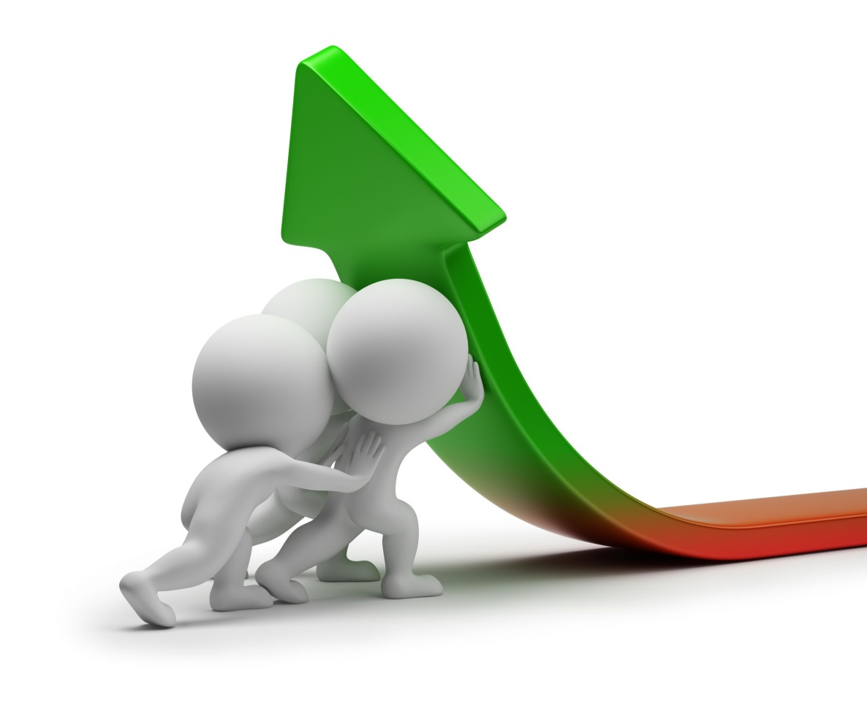
SOCIAL CAPITAL = VALUE generated by a GROUP through DEPENDABILITY, RELATIONSHIPS, PRINCIPLES, STANDARDS & ATTITUDE
Notes:
Lance Armstrong

Slide 4
The Law of Value
What Has Value
Protected,
Preserved
Put Used
Notes:
List for groceries Money – Difference is the Value both are paper

Slide 5
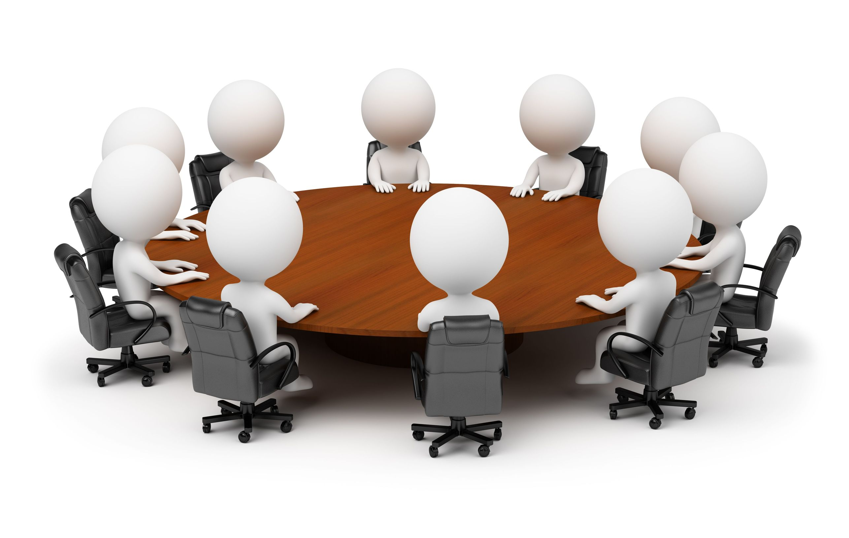
The Roundtable

Slide 8
Steps To Transformation

